Slide 1
What Is the Problem of the K-Means Method?
The k-means algorithm is sensitive to outliers !
  Since an object with an extremely large value may substantially distort the distribution of the data.
K-Medoids: Instead of taking the mean value of the object in a cluster as a reference point, medoids can be used, which is the most centrally located object in a cluster.
10
10
9
9
8
8
7
7
6
6
5
5
4
4
3
3
2
2
1
1
0
0
1
2
3
4
5
6
7
8
9
10
0
0
1
2
3
4
5
6
7
8
9
10

Slide 2
The K-Medoids Clustering Method
Find representative objects, called medoids, in clusters
PAM (Partitioning Around Medoids, 1987)
  starts from an initial set of medoids and iteratively replaces one of the medoids by one of the non-medoids if it improves the total distance of the resulting clustering
  PAM works effectively for small data sets, but does not scale well for large data sets
CLARA (Kaufmann & Rousseeuw, 1990)
CLARANS (Ng & Han, 1994): Randomized sampling
Focusing + spatial data structure (Ester et al., 1995)

Slide 3

A Typical K-Medoids Algorithm (PAM)
Total Cost = 20
10
9
8
Arbitrary choose k object as initial medoids
Assign each remaining object to nearest medoids
7
6
5
4
3
2
1
0
0
1
2
3
4
5
6
7
8
9
10
K=2
Randomly select a nonmedoid object,O_{ramdom}
Total Cost = 26
Do loop
Until no change
10
10
9
Compute total cost of swapping
9
Swapping O and O_{ramdom}
If quality is improved.
8
8
7
7
6
6
5
5
4
4
3
3
2
2
1
1
0
0
1
2
3
4
5
6
7
8
9
10
0
0
1
2
3
4
5
6
7
8
9
10

Slide 4
PAM (Partitioning Around Medoids) (1987)
PAM (Kaufman and Rousseeuw, 1987), built in Splus
Use real object to represent the cluster
  Select k representative objects arbitrarily
  For each pair of non-selected object h and selected object i, calculate the total swapping cost TC_{ih}
  For each pair of i and h,
    If TC_{ih} < 0, i is replaced by h
    Then assign each non-selected object to the most similar representative object
  repeat steps 2-3 until there is no change

Slide 5
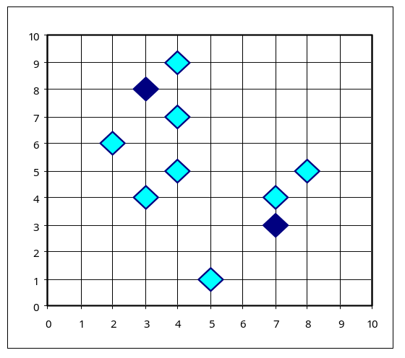
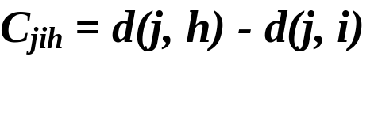

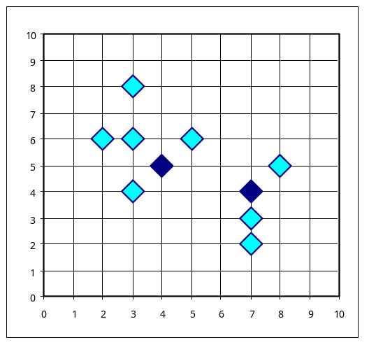
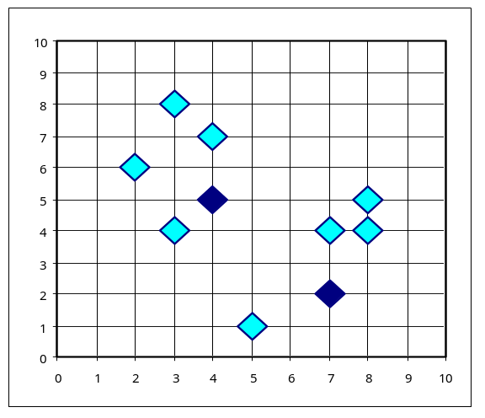


PAM Clustering: Total swapping cost TC_{ih}=∑_{j}C_{jih}
t
j
t
j
i
h
h
i
h
j
i
i
t
h
j
t

Slide 6
What Is the Problem with PAM?
Pam is more robust than k-means in the presence of noise and outliers because a medoid is less influenced by outliers or other extreme values than a mean
Pam works efficiently for small data sets but does not scale well for large data sets.
  O(k(n-k)² ) for each iteration
where n is # of data,k is # of clusters
Sampling based method,
CLARA(Clustering LARge Applications)

Slide 7
Limitations of K-means
K-means has problems when clusters are of differing
  Sizes
  Densities
  Non-globular shapes
K-means has problems when the data contains outliers.

Slide 8


Limitations of K-means: Differing Sizes
Original Points
K-means (3 Clusters)

Slide 9


Limitations of K-means: Differing Density
Original Points
K-means (3 Clusters)

Slide 10


Limitations of K-means: Non-globular Shapes
Original Points
K-means (2 Clusters)

Slide 11

Overcoming K-means Limitations
Original Points K-means Clusters
One solution is to use many clusters.
  Find parts of clusters, but need to put together.

Slide 12
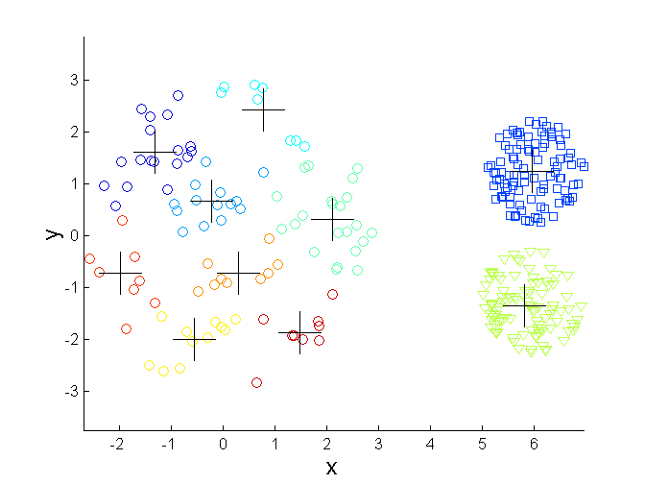
Overcoming K-means Limitations
Original Points K-means Clusters

Slide 13
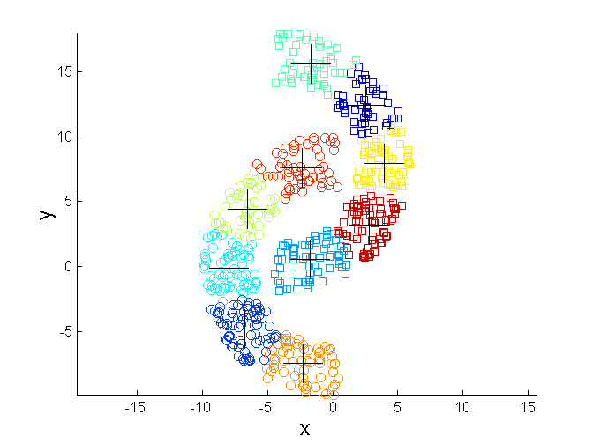
Overcoming K-means Limitations
Original Points K-means Clusters

Slide 14


Hierarchical Clustering
Produces a set of nested clusters organized as a hierarchical tree
Can be visualized as a dendrogram
  A tree like diagram that records the sequences of merges or splits

Slide 15
Strengths of Hierarchical Clustering
Do not have to assume any particular number of clusters
  Any desired number of clusters can be obtained by ‘cutting’ the dendogram at the proper level
They may correspond to meaningful taxonomies
  Example in biological sciences (e.g., animal kingdom, phylogeny reconstruction, …)

Slide 16
Hierarchical Clustering
Two main types of hierarchical clustering
  Agglomerative:
    Start with the points as individual clusters
    At each step, merge the closest pair of clusters until only one cluster (or k clusters) left
  Divisive:
    Start with one, all-inclusive cluster
    At each step, split a cluster until each cluster contains a point (or there are k clusters)
Traditional hierarchical algorithms use a similarity or distance matrix
  Merge or split one cluster at a time

Slide 17
Agglomerative Clustering Algorithm
More popular hierarchical clustering technique
Basic algorithm is straightforward
  Compute the proximity matrix
  Let each data point be a cluster
  Repeat
  Merge the two closest clusters
  Update the proximity matrix
  Until only a single cluster remains
Key operation is the computation of the proximity of two clusters
  Different approaches to defining the distance between clusters distinguish the different algorithms

Slide 18
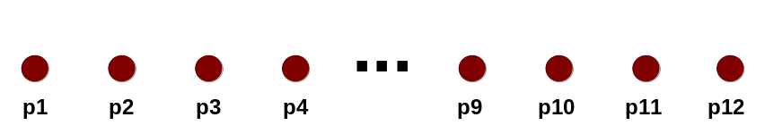
Starting Situation
Start with clusters of individual points and a proximity matrix
p1
p2
p3
p4
p5
. . .
p1
p2
p3
p4
p5
.
.
.
Proximity Matrix

Slide 19
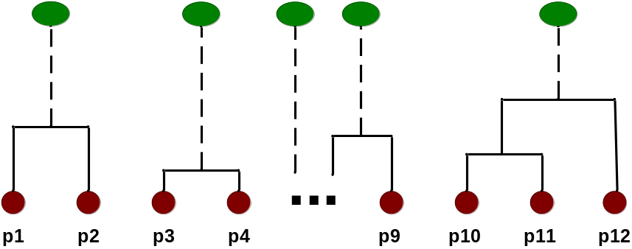
Intermediate Situation
After some merging steps, we have some clusters
C1
C2
C3
C4
C5
C1
C2
C3
C3
C4
C4
C5
Proximity Matrix
C1
C2
C5

Slide 20

Intermediate Situation
We want to merge the two closest clusters (C2 and C5) and update the proximity matrix.
C1
C2
C3
C4
C5
C1
C2
C3
C3
C4
C4
C5
Proximity Matrix
C1
C2
C5

Slide 21

After Merging
The question is “How do we update the proximity matrix?”
C2 U C5
C1
C3
C4
C1
?
C2 U C5
? ? ? ?
C3
C3
?
C4
C4
?
Proximity Matrix
C1
C2 U C5

Slide 22
How to Define Inter-Cluster Similarity
p1
p2
p3
p4
p5
. . .
p1
Similarity?
p2
p3
p4
p5
MIN
MAX
Group Average
Distance Between Centroids
Other methods driven by an objective function
  Ward’s Method uses squared error
.
.
.
Proximity Matrix

Slide 23
How to Define Inter-Cluster Similarity
p1
p2
p3
p4
p5
. . .
p1
p2
p3
p4
p5
MIN
MAX
Group Average
Distance Between Centroids
Other methods driven by an objective function
  Ward’s Method uses squared error
.
.
.
Proximity Matrix

Slide 24
How to Define Inter-Cluster Similarity
p1
p2
p3
p4
p5
. . .
p1
p2
p3
p4
p5
MIN
MAX
Group Average
Distance Between Centroids
Other methods driven by an objective function
  Ward’s Method uses squared error
.
.
.
Proximity Matrix

Slide 25
How to Define Inter-Cluster Similarity
p1
p2
p3
p4
p5
. . .
p1
p2
p3
p4
p5
MIN
MAX
Group Average
Distance Between Centroids
Other methods driven by an objective function
  Ward’s Method uses squared error
.
.
.
Proximity Matrix

Slide 26
How to Define Inter-Cluster Similarity
p1
p2
p3
p4
p5
. . .
p1
×
×
p2
p3
p4
p5
MIN
MAX
Group Average
Distance Between Centroids
Other methods driven by an objective function
  Ward’s Method uses squared error
.
.
.
Proximity Matrix

Slide 27
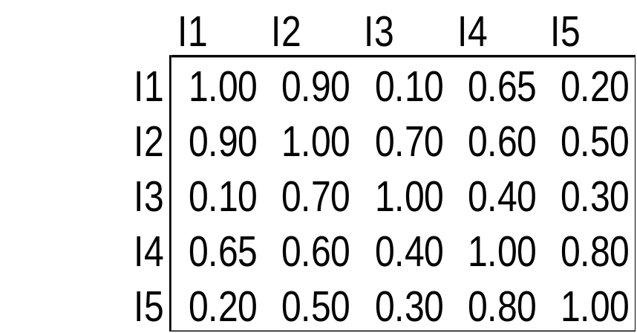
Cluster Similarity: MIN or Single Link
Similarity of two clusters is based on the two most similar (closest) points in the different clusters
  Determined by one pair of points, i.e., by one link in the proximity graph.
1
2
3
4
5

Slide 28

Hierarchical Clustering: MIN
5
1
3
5
2
1
2
3
6
4
4
Nested Clusters
Dendrogram

Slide 29
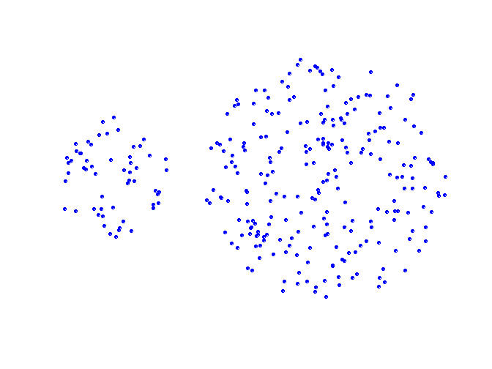
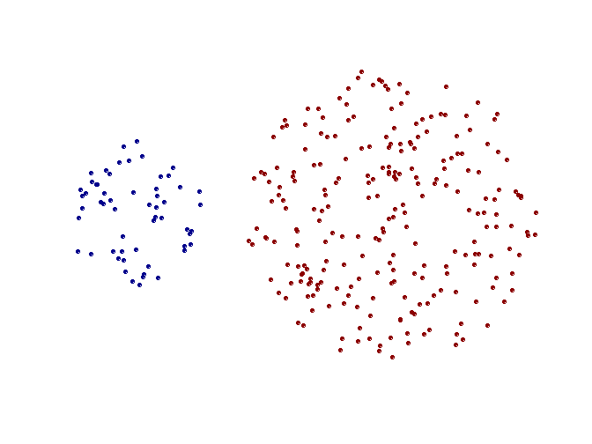
Strength of MIN
Original Points
Two Clusters
Can handle non-elliptical shapes

Slide 30
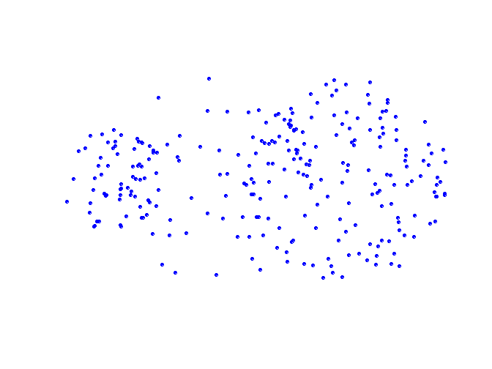
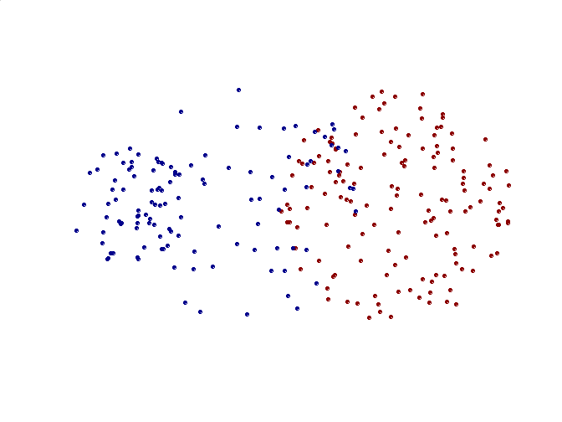
Limitations of MIN
Original Points
Two Clusters
Sensitive to noise and outliers

Slide 31

Cluster Similarity: MAX or Complete Linkage
Similarity of two clusters is based on the two least similar (most distant) points in the different clusters
  Determined by all pairs of points in the two clusters
1
2
3
4
5

Slide 32
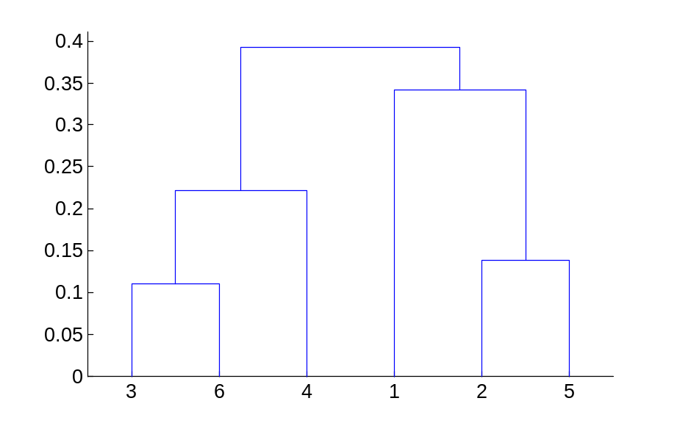
Hierarchical Clustering: MAX
4
1
2
5
5
2
3
6
3
1
4
Nested Clusters
Dendrogram

Slide 33
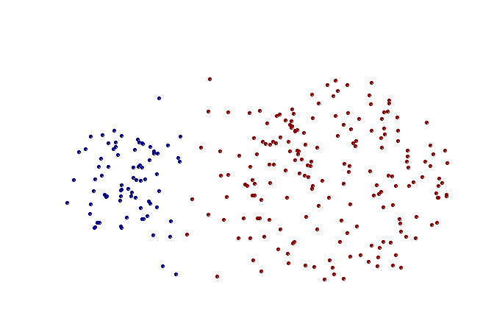
Strength of MAX
Original Points
Two Clusters
Less susceptible to noise and outliers

Slide 34
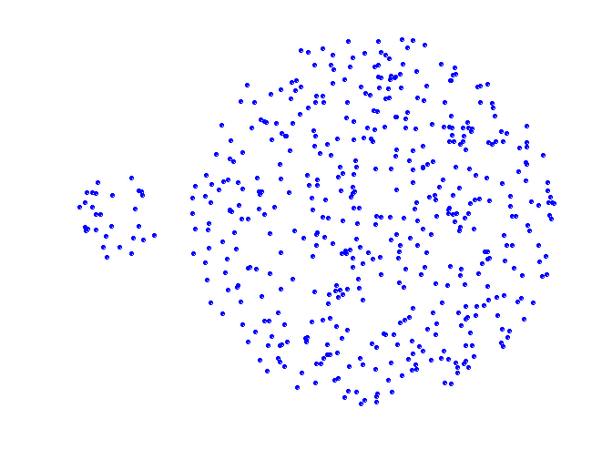
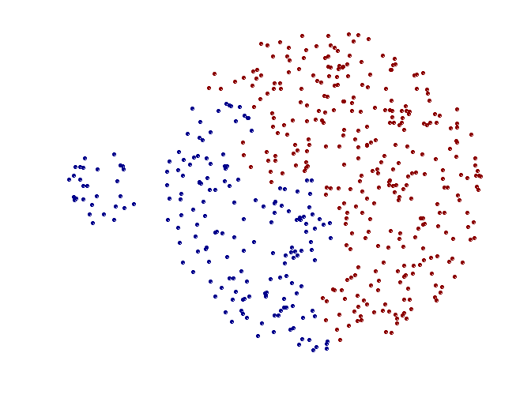
Limitations of MAX
Original Points
Two Clusters
Tends to break large clusters
Biased towards globular clusters

Slide 35
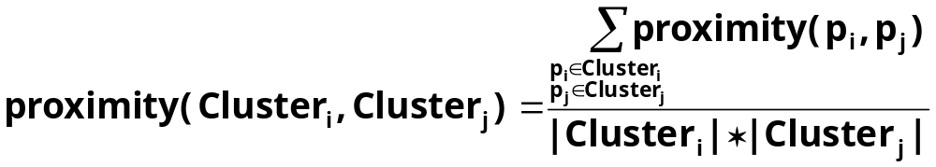

Cluster Similarity: Group Average
Proximity of two clusters is the average of pairwise proximity between points in the two clusters.
Need to use average connectivity for scalability since total proximity favors large clusters
1
2
3
4
5

Slide 36

Hierarchical Clustering: Group Average
5
4
1
2
5
2
3
6
1
4
3
Nested Clusters
Dendrogram

Slide 37
Hierarchical Clustering: Group Average
Compromise between Single and Complete Link
Strengths
  Less susceptible to noise and outliers
Limitations
  Biased towards globular clusters

Slide 38
Cluster Similarity: Ward’s Method
Similarity of two clusters is based on the increase in squared error when two clusters are merged
  Similar to group average if distance between points is distance squared
Less susceptible to noise and outliers
Biased towards globular clusters
Hierarchical analogue of K-means
  Can be used to initialize K-means

Slide 39
Hierarchical Clustering: Comparison
5
1
4
1
3
2
5
5
5
2
1
MIN
2
MAX
2
3
6
3
3
6
1
4
4
4
5
5
1
4
1
2
2
5
2
Ward’s Method
5
2
3
6
Group Average
3
3
6
4
1
1
4
4
3

Slide 40
Hierarchical Clustering: Time and Space requirements
O(N²) space since it uses the proximity matrix.
  N is the number of points.
O(N³) time in many cases
  There are N steps and at each step the size, N², proximity matrix must be updated and searched
  Complexity can be reduced to O(N² log(N) ) time for some approaches

Slide 41
Hierarchical Clustering: Problems and Limitations
Once a decision is made to combine two clusters, it cannot be undone
No objective function is directly minimized
Different schemes have problems with one or more of the following:
  Sensitivity to noise and outliers
  Difficulty handling different sized clusters and convex shapes
  Breaking large clusters

Slide 42
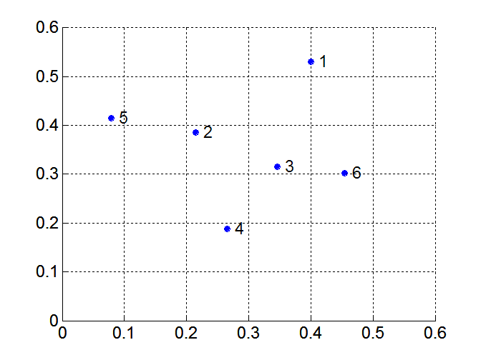
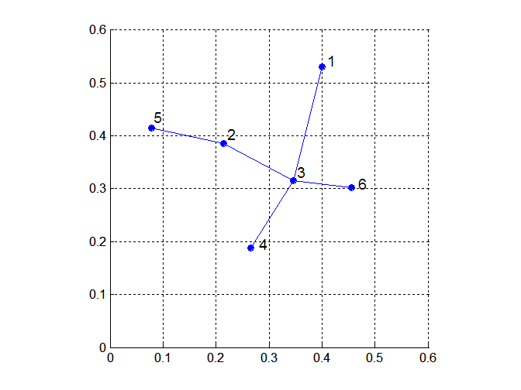
MST: Divisive Hierarchical Clustering
Build MST (Minimum Spanning Tree)
  Start with a tree that consists of any point
  In successive steps, look for the closest pair of points (p, q) such that one point (p) is in the current tree but the other (q) is not
  Add q to the tree and put an edge between p and q

Slide 43
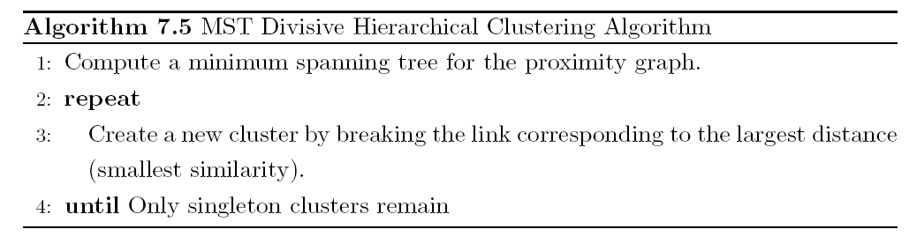
MST: Divisive Hierarchical Clustering
Use MST for constructing hierarchy of clusters

Slide 44
DBSCAN
DBSCAN is a density-based algorithm.
  Density = number of points within a specified radius (Eps)
  A point is a core point if it has more than a specified number of points (MinPts) within Eps
    These are points that are at the interior of a cluster
  A border point has fewer than MinPts within Eps, but is in the neighborhood of a core point
  A noise point is any point that is not a core point or a border point.

Slide 45

DBSCAN: Core, Border, and Noise Points

Slide 46
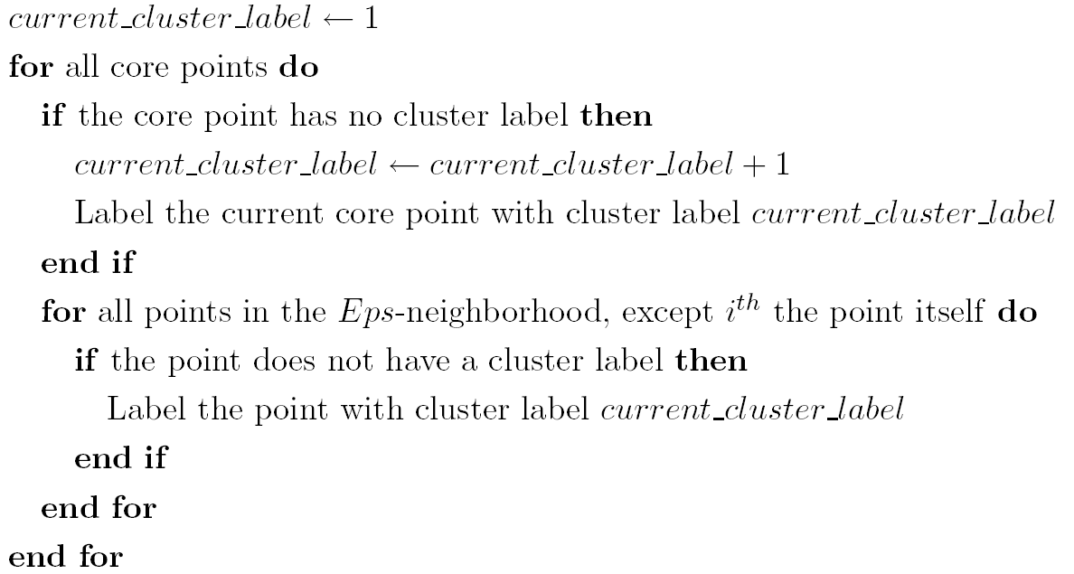
DBSCAN Algorithm
Eliminate noise points
Perform clustering on the remaining points

Slide 47


DBSCAN: Core, Border and Noise Points
Original Points
Point types: core, border and noise
Eps = 10, MinPts = 4

Slide 48

When DBSCAN Works Well
Original Points
Clusters
Resistant to Noise
Can handle clusters of different shapes and sizes

Slide 49



When DBSCAN Does NOT Work Well
(MinPts=4, Eps=9.75).
Original Points
Varying densities
High-dimensional data
(MinPts=4, Eps=9.92)

Slide 50
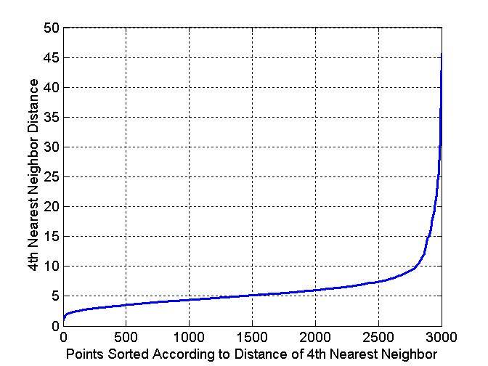
DBSCAN: Determining EPS and MinPts
Idea is that for points in a cluster, their k^{th} nearest neighbors are at roughly the same distance
Noise points have the k^{th} nearest neighbor at farther distance
So, plot sorted distance of every point to its k^{th} nearest neighbor

Slide 51
Cluster Validity
For supervised classification we have a variety of measures to evaluate how good our model is
  Accuracy, precision, recall
For cluster analysis, the analogous question is how to evaluate the “goodness” of the resulting clusters?
But “clusters are in the eye of the beholder”!
Then why do we want to evaluate them?
  To avoid finding patterns in noise
  To compare clustering algorithms
  To compare two sets of clusters
  To compare two clusters

Slide 52
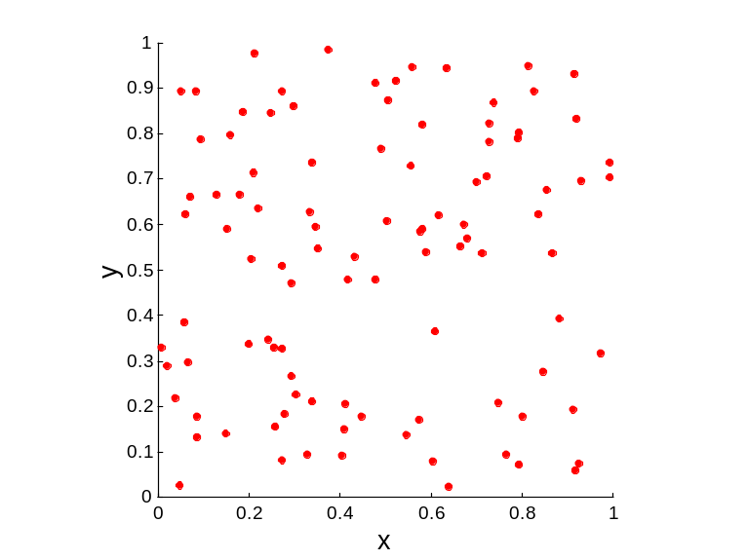
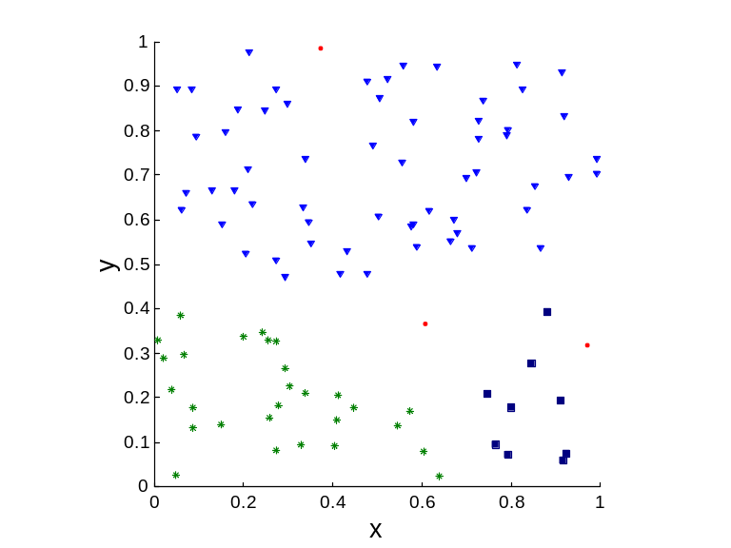
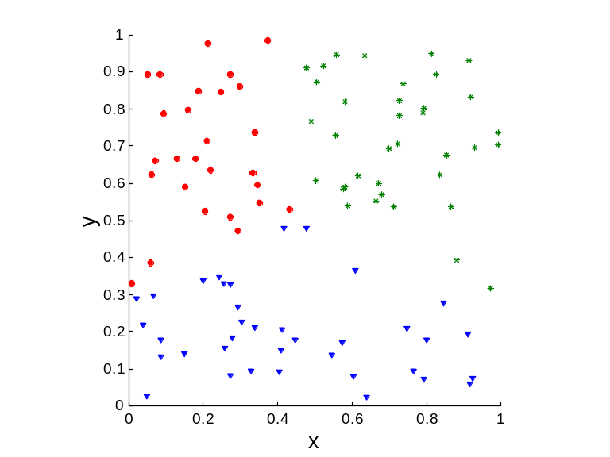
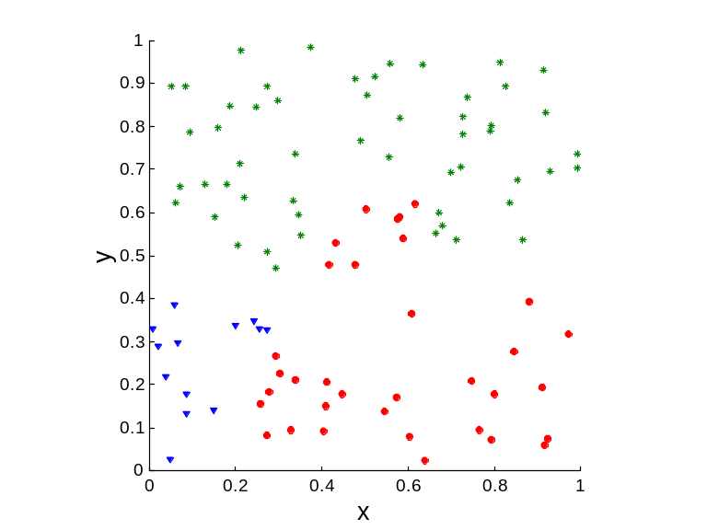
Clusters found in Random Data
Random Points
DBSCAN
K-means
Complete Link

Slide 53
Different Aspects of Cluster Validation
Determining the clustering tendency of a set of data, i.e., distinguishing whether non-random structure actually exists in the data.
Comparing the results of a cluster analysis to externally known results, e.g., to externally given class labels.
Evaluating how well the results of a cluster analysis fit the data without reference to external information.
  - Use only the data
Comparing the results of two different sets of cluster analyses to determine which is better.
Determining the ‘correct’ number of clusters.
For 2, 3, and 4, we can further distinguish whether we want to evaluate the entire clustering or just individual clusters.

Slide 54
Measures of Cluster Validity
Numerical measures that are applied to judge various aspects of cluster validity, are classified into the following three types.
  External Index: Used to measure the extent to which cluster labels match externally supplied class labels.
    Entropy
  Internal Index: Used to measure the goodness of a clustering structure without respect to external information.
    Sum of Squared Error (SSE)
  Relative Index: Used to compare two different clusterings or clusters.
    Often an external or internal index is used for this function, e.g., SSE or entropy
Sometimes these are referred to as criteria instead of indices
  However, sometimes criterion is the general strategy and index is the numerical measure that implements the criterion.

Slide 55
Measuring Cluster Validity Via Correlation
Two matrices
  Proximity Matrix
  “Incidence” Matrix
    One row and one column for each data point
    An entry is 1 if the associated pair of points belong to the same cluster
    An entry is 0 if the associated pair of points belongs to different clusters
Compute the correlation between the two matrices
  Since the matrices are symmetric, only the correlation between
  n(n-1) / 2 entries needs to be calculated.
High correlation indicates that points that belong to the same cluster are close to each other.
Not a good measure for some density or contiguity based clusters.

Slide 56
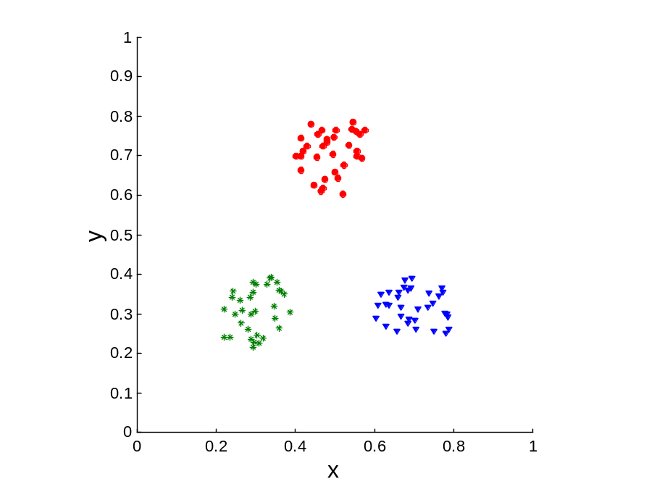
Measuring Cluster Validity Via Correlation
Correlation of incidence and proximity matrices for the K-means clusterings of the following two data sets.
Corr = 0.9235
Corr = 0.5810

Slide 57
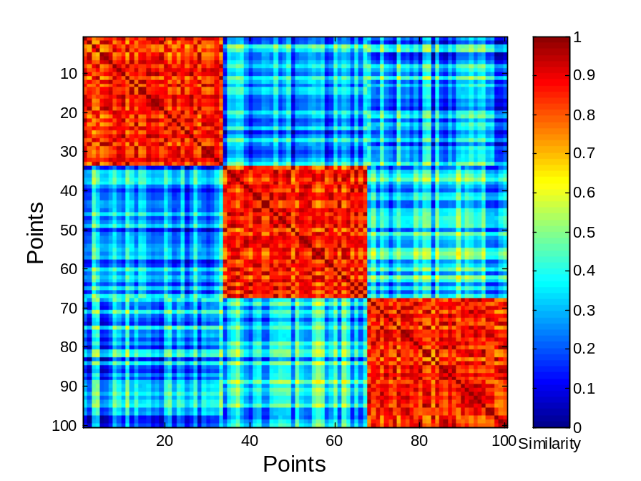
Using Similarity Matrix for Cluster Validation
Order the similarity matrix with respect to cluster labels and inspect visually.

Slide 58
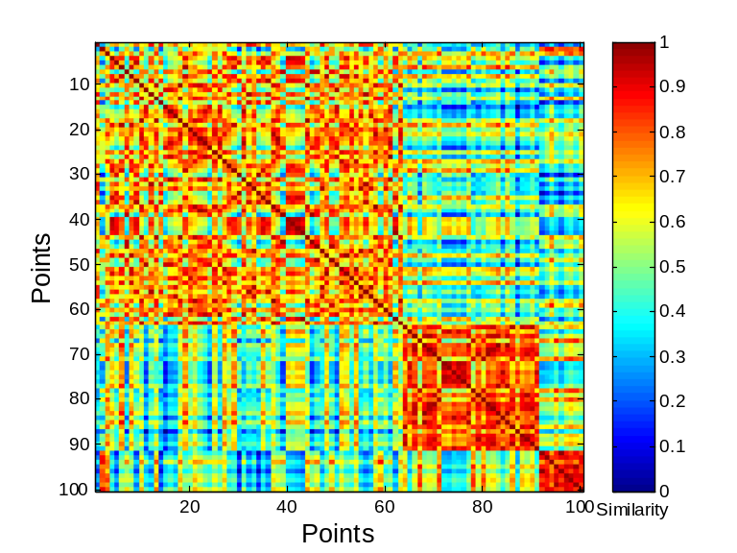
Using Similarity Matrix for Cluster Validation
Clusters in random data are not so crisp
DBSCAN

Slide 59
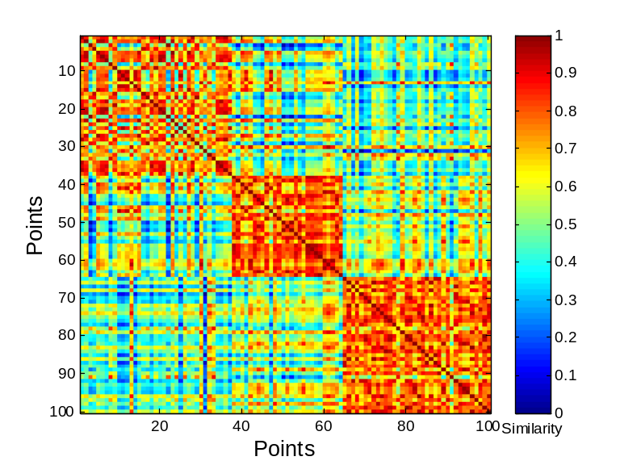
Using Similarity Matrix for Cluster Validation
Clusters in random data are not so crisp
K-means

Slide 60
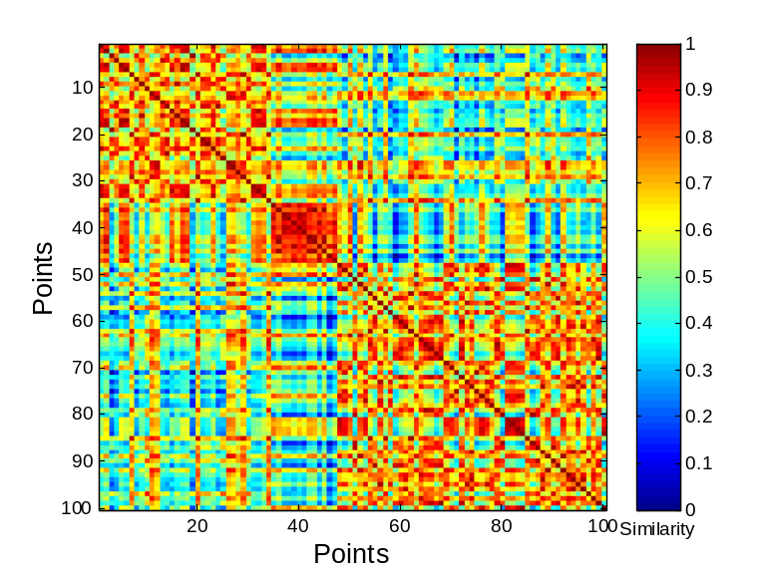
Using Similarity Matrix for Cluster Validation
Clusters in random data are not so crisp
Complete Link

Slide 61
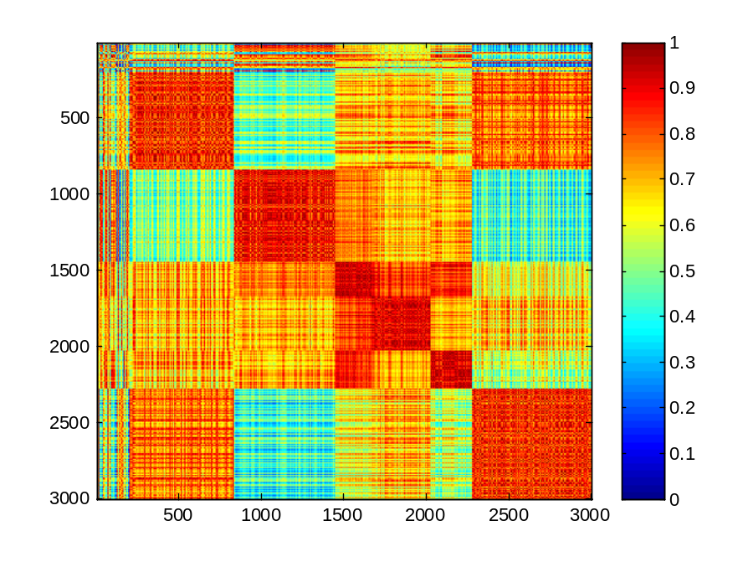
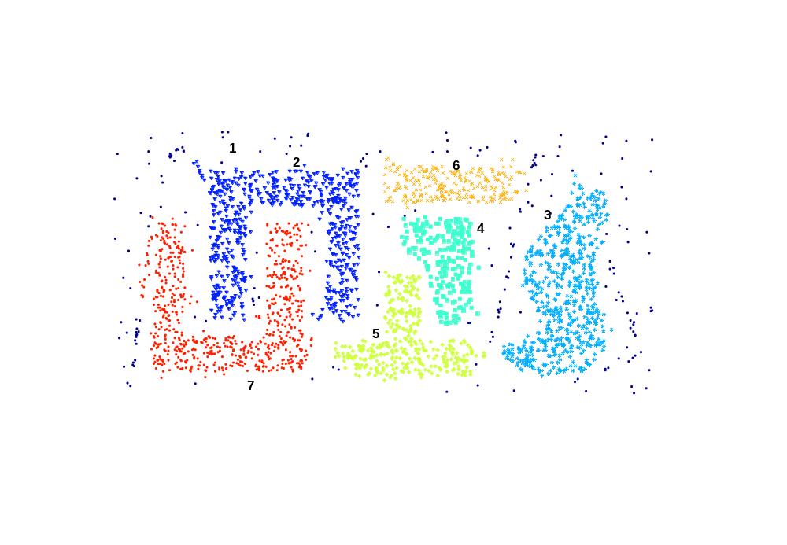
Using Similarity Matrix for Cluster Validation
DBSCAN

Slide 62
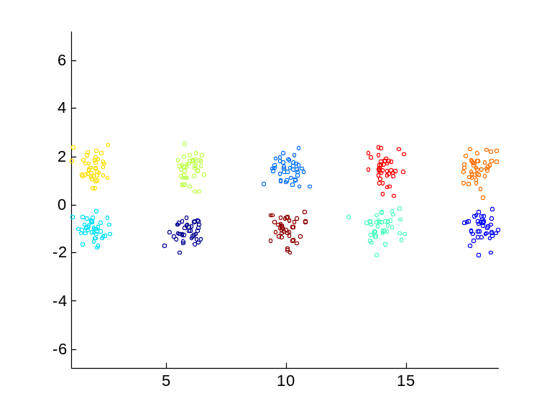
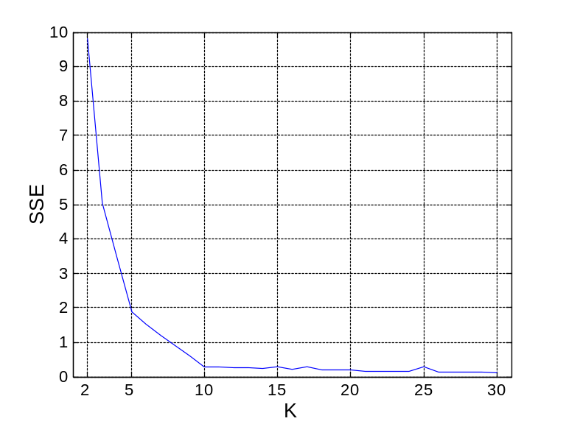
Internal Measures: SSE
Clusters in more complicated figures aren’t well separated
Internal Index: Used to measure the goodness of a clustering structure without respect to external information
  SSE
SSE is good for comparing two clusterings or two clusters (average SSE).
Can also be used to estimate the number of clusters

Slide 63
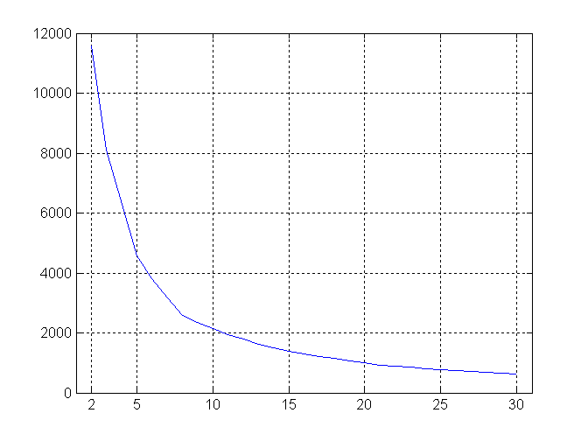
Internal Measures: SSE
SSE curve for a more complicated data set
SSE of clusters found using K-means

Slide 64
Framework for Cluster Validity
Need a framework to interpret any measure.
  For example, if our measure of evaluation has the value, 10, is that good, fair, or poor?
Statistics provide a framework for cluster validity
  The more “atypical” a clustering result is, the more likely it represents valid structure in the data
  Can compare the values of an index that result from random data or clusterings to those of a clustering result.
    If the value of the index is unlikely, then the cluster results are valid
  These approaches are more complicated and harder to understand.
For comparing the results of two different sets of cluster analyses, a framework is less necessary.
  However, there is the question of whether the difference between two index values is significant

Slide 65
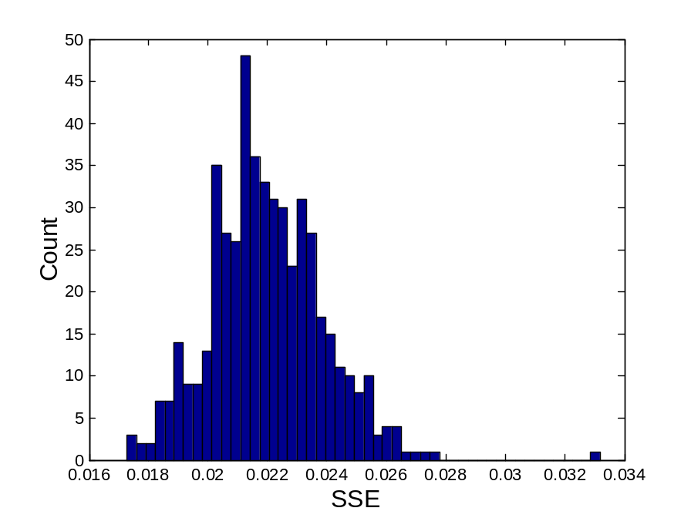
Statistical Framework for SSE
Example
  Compare SSE of 0.005 against three clusters in random data
  Histogram shows SSE of three clusters in 500 sets of random data points of size 100 distributed over the range 0.2 – 0.8 for x and y values

Slide 66
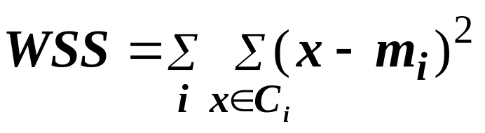
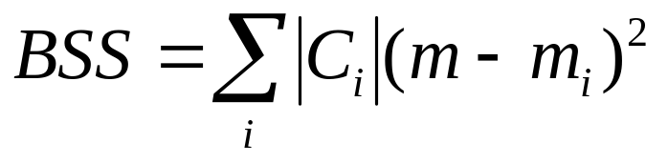
Internal Measures: Cohesion and Separation
Cluster Cohesion: Measures how closely related are objects in a cluster
  Example: SSE
Cluster Separation: Measure how distinct or well-separated a cluster is from other clusters
Example: Squared Error
  Cohesion is measured by the within cluster sum of squares (SSE)
  Separation is measured by the between cluster sum of squares
      Where |C_{i}| is the size of cluster i

Slide 67
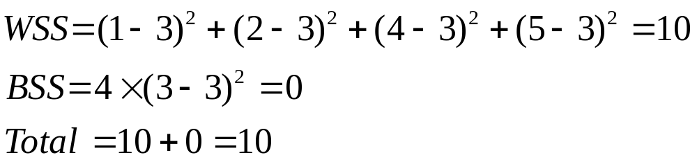
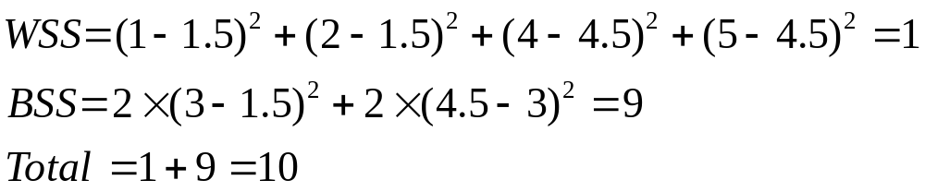
Internal Measures: Cohesion and Separation
Example: SSE
  BSS + WSS = constant
m
×
×
×
1
m₁
2
3
4
m₂
5
K=1 cluster:
K=2 clusters:

Slide 68
Internal Measures: Cohesion and Separation
A proximity graph based approach can also be used for cohesion and separation.
  Cluster cohesion is the sum of the weight of all links within a cluster.
  Cluster separation is the sum of the weights between nodes in the cluster and nodes outside the cluster.
cohesion
separation

Slide 69
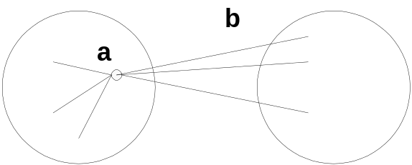
Internal Measures: Silhouette Coefficient
Silhouette Coefficient combine ideas of both cohesion and separation, but for individual points, as well as clusters and clusterings
For an individual point, i
  Calculate a = average distance of i to the points in its cluster
  Calculate b = min (average distance of i to points in another cluster)
  The silhouette coefficient for a point is then given by
  s = 1 – a/b if a < b, (or s = b/a - 1 if a ≥ b, not the usual case)
  Typically between 0 and 1.
  The closer to 1 the better.
Can calculate the Average Silhouette width for a cluster or a clustering

Slide 70
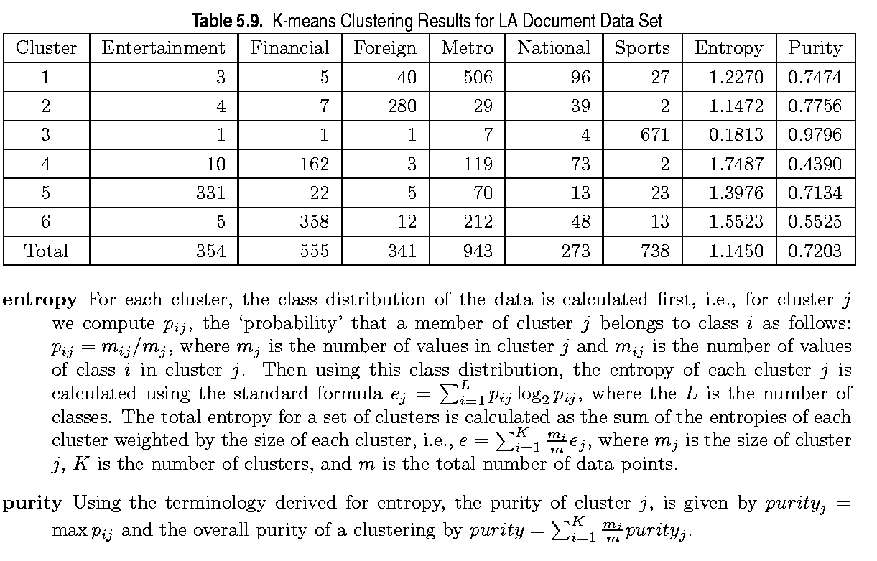
External Measures of Cluster Validity: Entropy and Purity

Slide 71
Final Comment on Cluster Validity
“The validation of clustering structures is the most difficult and frustrating part of cluster analysis.
Without a strong effort in this direction, cluster analysis will remain a black art accessible only to those true believers who have experience and great courage.”
Algorithms for Clustering Data, Jain and Dubes

